Slide 1
Architectural Styles Overview
Pravin Y Pawar

Slide 2
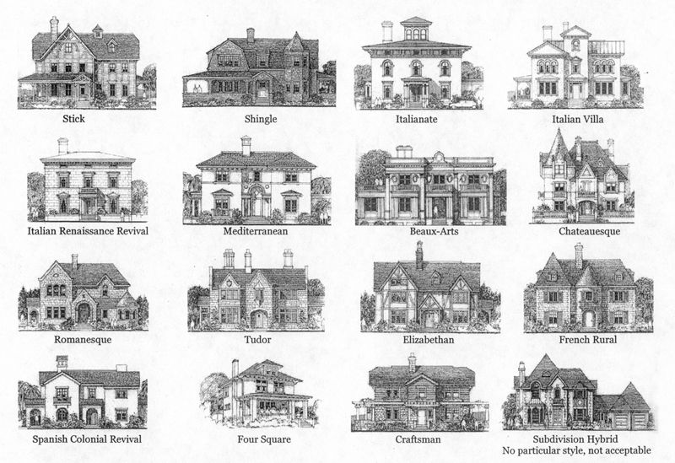
An architecture style
A family of architectures that share certain characteristics
For example,
N-tier is a common architecture style.
More recently, microservice architectures have started to gain favor
Architecture styles don't require the use of particular technologies, but some technologies are well-suited for certain architectures
For example, containers are a natural fit for microservices
source : pintrest

Slide 3
A quick tour of the styles
A set of architecture styles that are commonly found in cloud applications
N-tier
Web-Queue-Worker
Microservices
Event-driven architecture
Big Data, Big Compute

Slide 4
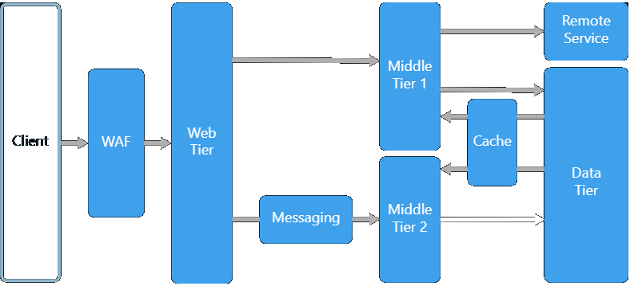
N-tier
A traditional architecture for enterprise applications
Dependencies are managed by dividing the application into layers that perform logical functions, such as
presentation,
business logic,
and data access
A layer can only call into layers that sit below it
this horizontal layering can be a liability
can be hard to introduce changes in one part of the application without touching the rest of the application
makes frequent updates a challenge, limiting how quickly new features can be added
Is a natural fit for migrating existing applications that already use a layered architecture
For that reason, often seen in
infrastructure as a service (IaaS) solutions,
or application that use a mix of IaaS and managed services
source : Microsoft

Slide 5
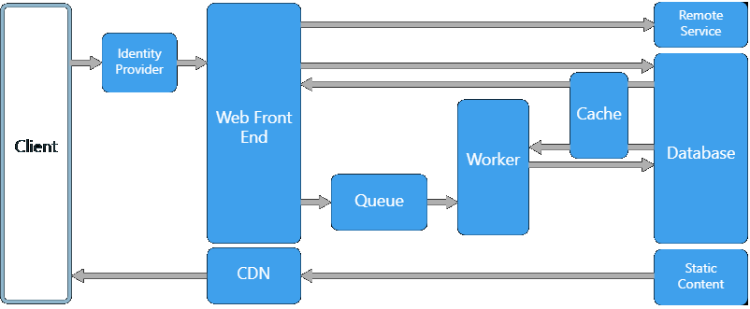
Web-Queue-Worker
For a purely PaaS solution, consider a Web-Queue-Worker architecture
Application has
a web front end that handles HTTP requests
a back-end worker that performs CPU-intensive tasks or long-running operations
front end communicates to the worker through an asynchronous message queue
Suitable for relatively simple domains with some resource-intensive tasks
easy to understand
use of managed services simplifies deployment and operations
But with complex domains, it can be hard to manage dependencies
front end and the worker can easily become large, monolithic components that are hard to maintain and update
source : Microsoft

Slide 6
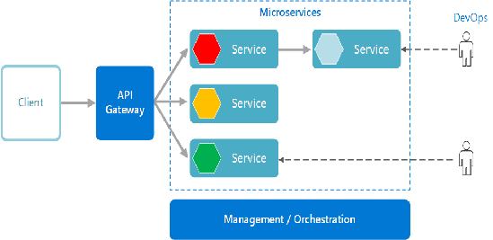
Microservices
If your application has a more complex domain, consider moving to a Microservices architecture
Microservice Application
is composed of many small, independent services
each service implements a single business capability
are loosely coupled, communicating through API contracts
can be built by a small, focused development team
More complex to build and manage than either N-tier or web-queue-worker
requires a mature development and DevOps culture
can lead to higher release velocity, faster innovation, and a more resilient architecture
source : Microsoft

Slide 7
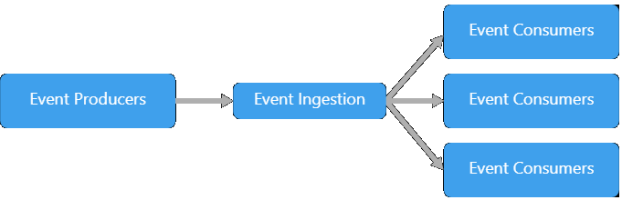
Event-driven architecture
Use a publish-subscribe (pub-sub) model, where producers publish events, and consumers subscribe to them
Producers are independent from the consumers, and consumers are independent from each other
Useful for applications that
ingest and process a large volume of data with very low latency, such as IoT solutions
has different subsystems must perform different types of processing on the same event data
source : Microsoft

Slide 8
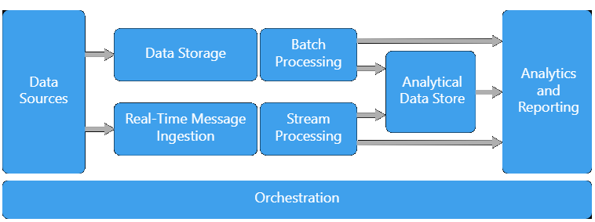
Big Data, Big Compute
Specialized architecture styles for workloads that fit certain specific profiles
Big data divides a very large dataset into chunks, performing parallel processing across the entire set, for analysis and reporting
Big compute, also called high-performance computing (HPC), makes parallel computations across a large number (thousands) of cores
Domains include simulations, modeling, and 3-D rendering.
source : Microsoft

Slide 9
Thank You!
Reference:
Azure Application Architecture Guide
In our next session:

